Slide 1
Programming Assignment 3 (1/3)
Multinomial NB Classifier:
Text collection:
The 1095 news documents.
13 classes (id 1~13), each class has 15 training documents.
https://ceiba.ntu.edu.tw/course/88ca22/content/training.txt
The remaining documents are for testing.
Send your result to Kaggle.
See kaggle教學詳細版.pdf for the detail of the output format
class_id training doc ids
11 19 29 113 …
1 2 3 4 …
…
13 485 520 523 …
training.txt

Slide 2
Programming Assignment 3 (2/3)
Note:
For each class, you have to calculate M P(X=t|c) parameters.
M is the size of your vocabulary.
Then, the total number of parameters in your system will be |C|*M ← can be a huge number.
We know that many terms in the vocabulary are not indicative.
Employ at least one feature selection method and use only 500 terms in your classification.
Χ² test.
Likelihood ratio.
Pointwise/expected MI.
Frequency-based methods.
When classify a testing document, terms not in the selected vocabulary are ignored.
指示性

Slide 3
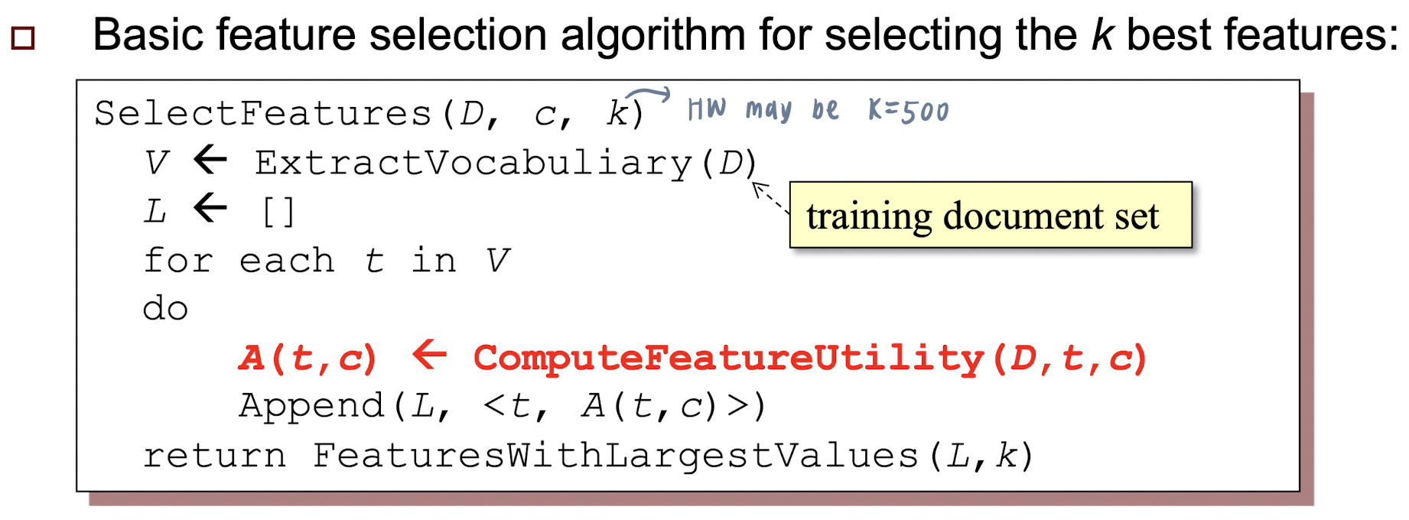

Slide 4
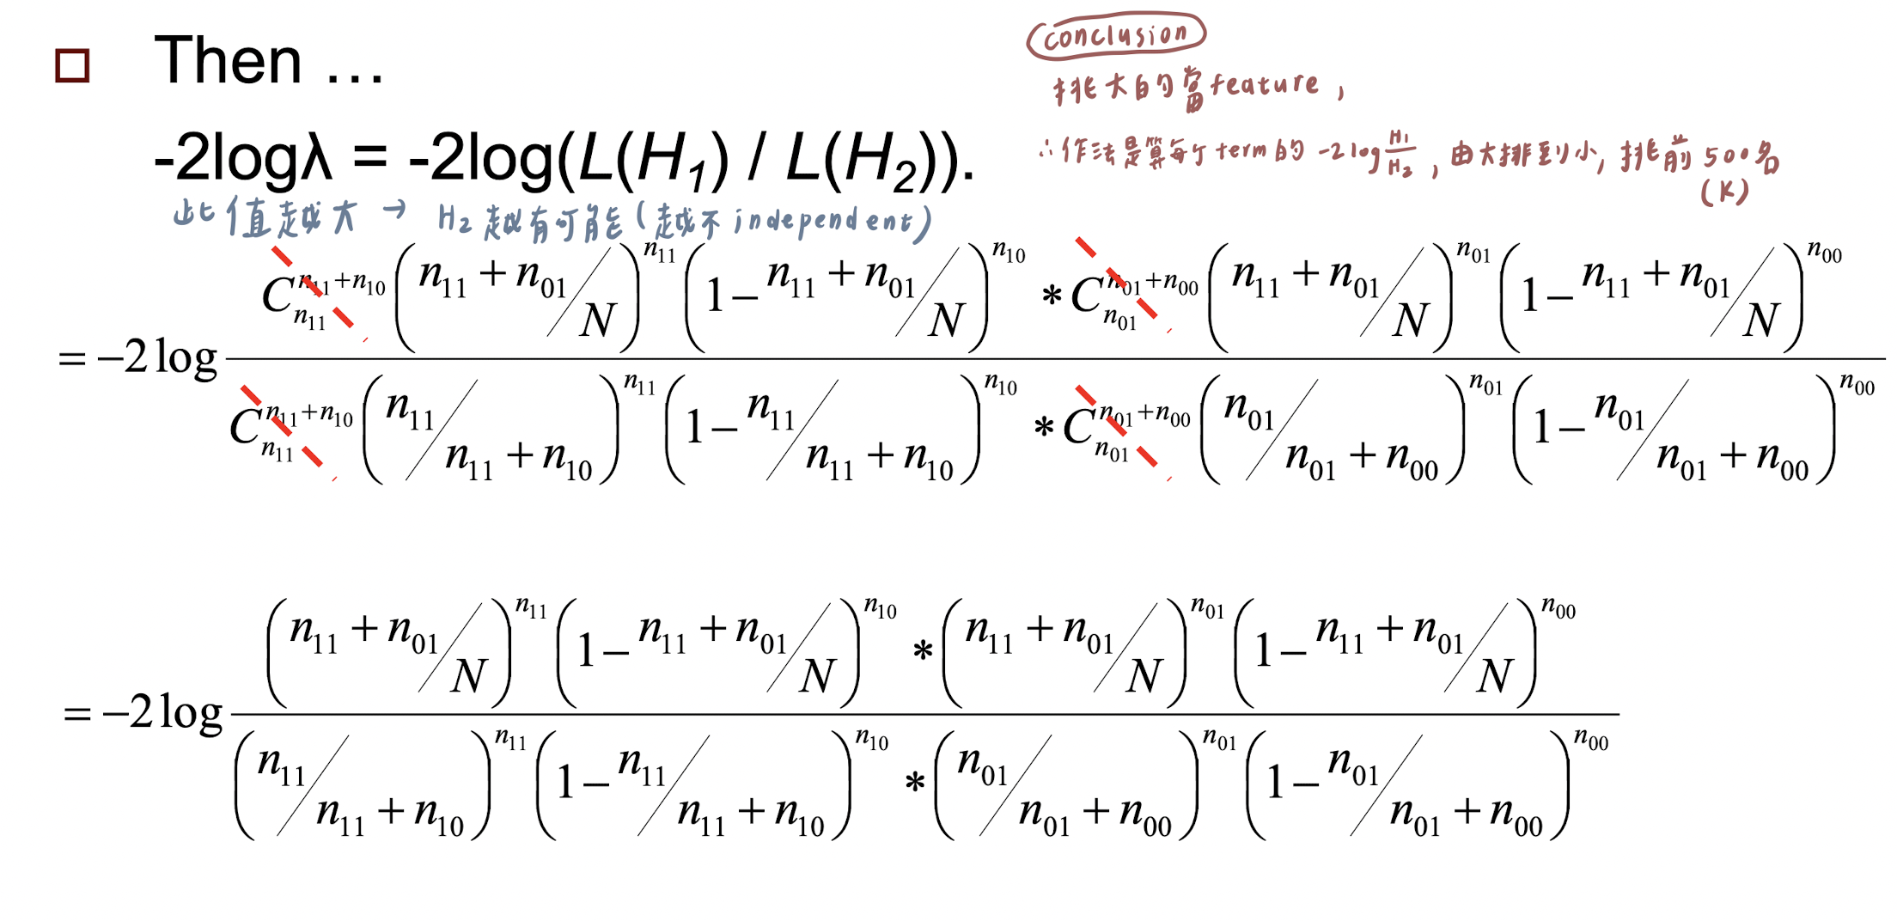

Slide 5
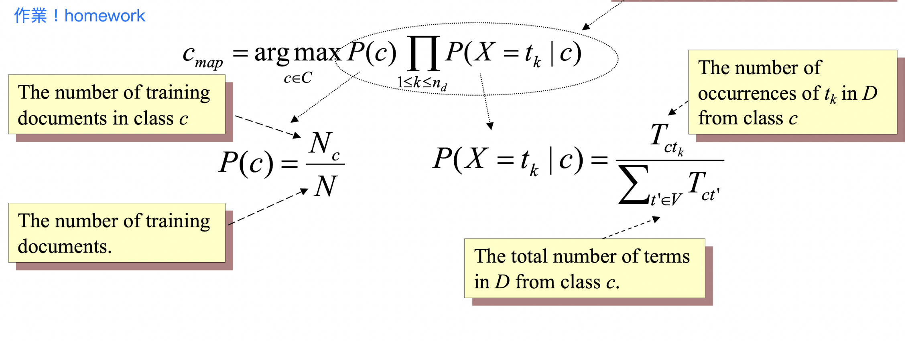
15
13x15=195

Slide 6
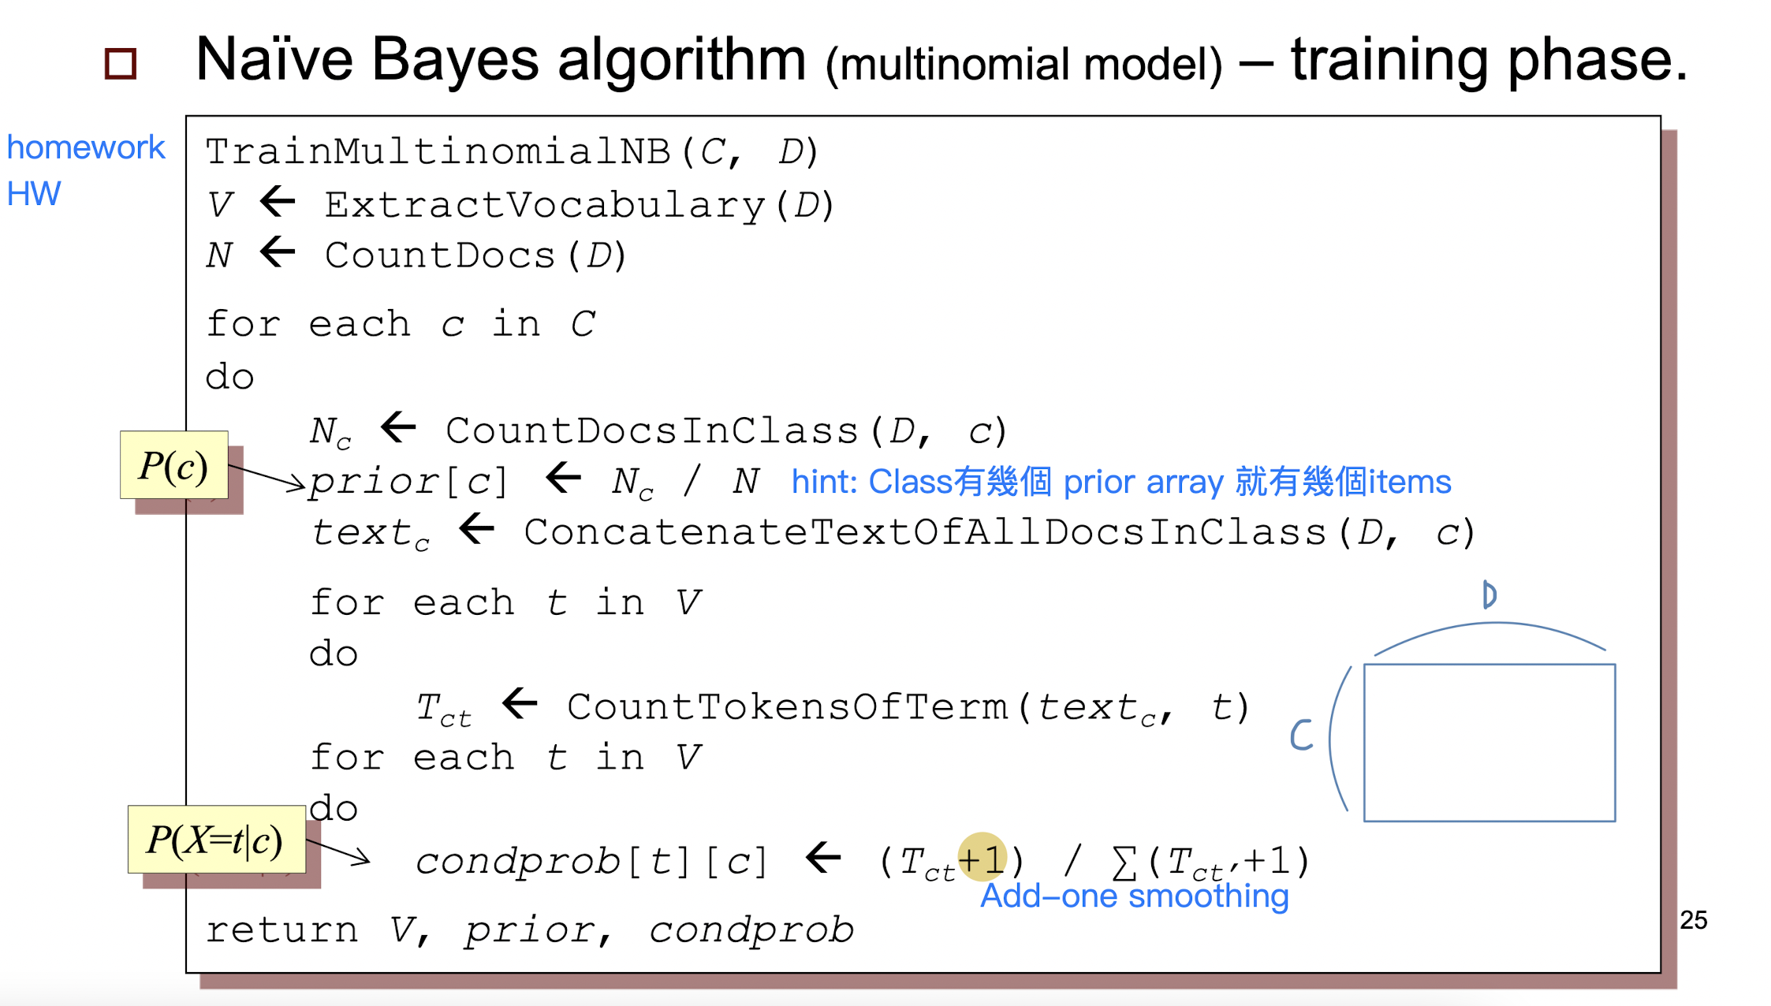
13*Top 50 = 650個字
195
15

Slide 7
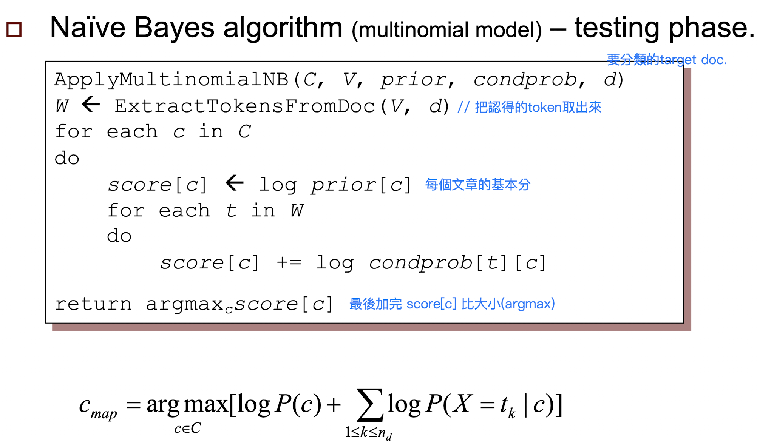

Slide 8
Programming Assignment 3 (3/3)
To avoid zero probabilities, calculate P(X=t|c) by using add-one smoothing.
Test your result on Kaggle !!
https://www.kaggle.com/t/001ab107135541378752ca9215000af0
Please zip and submit ^{1.}source code and ^{2.}a report to TA.
3 weeks to complete, that is, 2022/1/4.

